Slide 1
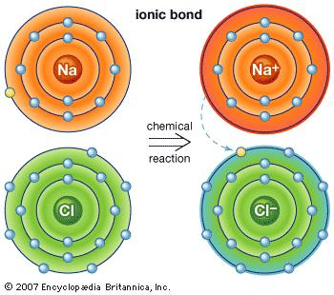
Chapter 7 – Ionic and Metallic Bonding
Augustine

Slide 2
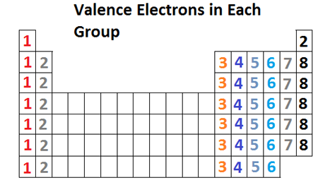
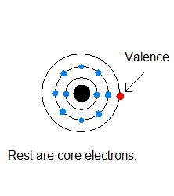
Section 7.1 - Ions
Valence electrons are the electrons in the highest occupied energy level.
Valence electrons are the only electrons involved in chemical bonding.
Elements in the same group have the same number of valence electrons.

Slide 3
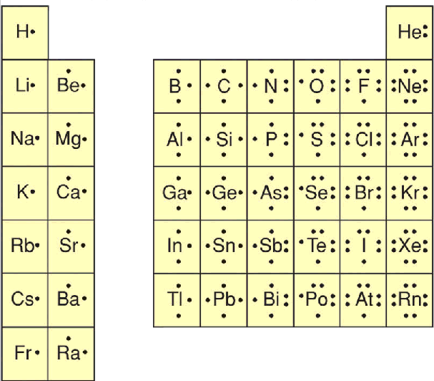
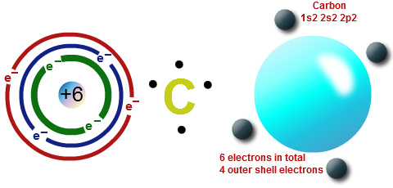
Electron Dot Structures
Electron dot structures are diagrams that show the symbol of the element surrounded by the valence electrons as dots.

Slide 4
Practice Problems
Write the electron dot structure for the following elements:
P
Ar
Mg
He

Slide 5
Octet Rule
The octet rule states that atoms tend to achieve a stable configuration when they have 8 valence electrons.
Metals tend to lose electrons to achieve noble-gas configuration. Nonmetals tend to gain electrons to achieve noble-gas configuration.

Slide 6
Cations
A cation ion is a positive ion that has lost electrons.
When writing the electron configuration for a cation, write the electron configuration for the atom and then subtract the electrons from the highest energy level.
When you name a cation, the name of the element does not change. Ex: Ca⁺² = calcium ion

Slide 7
Sample Problem
Write the electron configuration and name for the following:
Sr²⁺
Fe⁺³
1s²2s²2p⁶3s²3p⁶3d¹⁰4s²4p⁶
Strontium ion
1s²2s²2p⁶3s²3d⁵
Iron ion

Slide 8
Practice Problems
Write the electron configurations and the name for the following:
Zn⁺²
Na⁺
1s²2s²2p⁶3s²3p⁶3d¹⁰
Zinc ion
1s²2s²2p⁶
Sodium ion

Slide 9
Anions
Anions are negatively charged ions that have gained electrons.
When writing the electron configuration for anions, write the electron configuration for the atom and then add the correct number of electrons.
When naming an anion, you change the ending of the element to –ide. Ex: Cl⁻ = chloride ion

Slide 10
Sample Problems
Write the electron configuration and name for the following:
P⁻³
F⁻
1s²2s²2p⁶3s²3p⁶
Phosphide ion
1s²2s²2p⁶
Fluoride ion

Slide 11
Practice Problems
Write the electron configuration and name for the following:
Br⁻
S⁻²
1s²2s²2p⁶3s²3p⁶3d¹⁰4s²4p⁶
Bromide ion
1s²2s²2p⁶3s²3p⁶
Sulfide ion

Slide 12
Section 7.1 Assessment
How can you determine the number of valence electrons in an atom of a representative element?
Atoms of which elements tend to gain electrons? Atoms of which elements tend to lose electrons?
How do cations form?
How do anions form?
How many valence electrons are in each atom?
Potassium
Carbon
Magnesium
Oxygen
Draw the electron dot structure for each element in question 5.

Slide 13
Section 7.1 Assessment
7. How many electrons will each element gain or lose in forming an ion?
a. calcium
b. fluorine
c. aluminum
d. oxygen
8. Write the name and symbol of the ion formed when
a. a potassium atom loses one electron.
b. a zinc atom loses two electrons.
c. a fluorine atom gains one electron.
9. Write the electron configuration of Cd⁺².

Slide 14
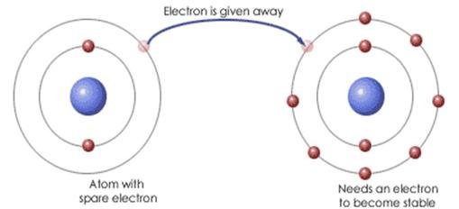
Section 7.2 – Ionic Bonds and Ionic Compounds
Compounds composed of cations and anions are called ionic compounds.
Although they are composed of ions, ionic compounds are electrically neutral.
The electrostatic forces that hold ions together are called ionic bonds.

Slide 15
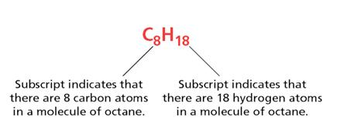
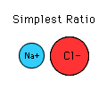
Formulas
A chemical formula shows the kinds and numbers of atoms in the smallest representative unit of a substance.
A formula unit is the lowest whole-number ratio of ions in an ionic compound.

Slide 16
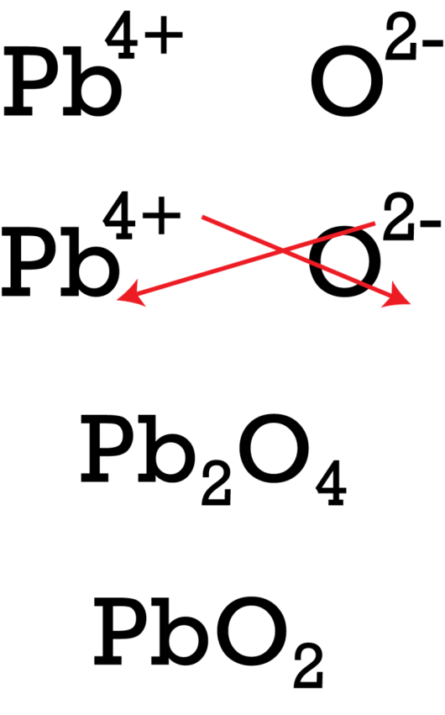
Balancing Charges
When you balance charges to write the formula for an ionic compound, you must make the + charge and – charge equal by adding subscripts.
The subscripts must be in the lowest ratio to be correct.

Slide 17
Sample Problems
Write the formula for the compound formed between the following elements.
Potassium and oxygen
Magnesium and nitrogen
K₂O
Mg₃N₂

Slide 18
Practice Problems
Write the formula for the compound when the following elements combine.
Potassium and iodine
Aluminum and oxygen
Calcium and chlorine
Barium and sulfur
KI
Al₂O₃
CaCl₂
BaS

Slide 19
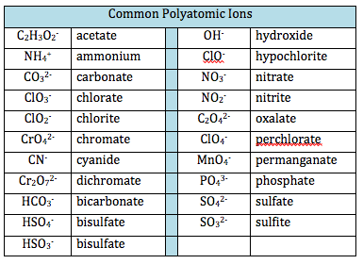
Polyatomic Ions
Polyatomic ions are a group of atoms with an overall charge.
When balancing charges for polyatomic ions, you follow the same rule of cancelling the + and – charge.
However, if you need to add a subscript to a polyatomic ion, then you have to put the polyatomic ion in parentheses. Ex: Ca(NO₃)₂

Slide 20
Sample Problems
Write the formula for the compound when the following ions combine:
Sodium and phosphate
Ammonium nitride
Aluminum carbonate
Na₃PO₄
(NH₄)₃N
Al₂(CO₃)₃

Slide 21
Practice Problems
Write the formula for the compound when the following ions combine:
Barium nitrate
Lithium phosphate
Strontium sulfite
Ba(NO₃)₂
Li₃PO₄
SrSO₃

Slide 22
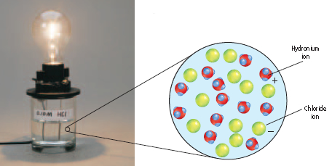
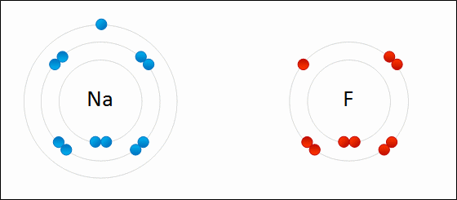
Properties of Ionic Compounds
Properties of ionic compounds include the following:
Crystalline solids
High melting points
Conduct electricity when molten or aqueous
Made of metals and nonmetals
Made of cations and anions
Made of ionic bonds

Slide 23
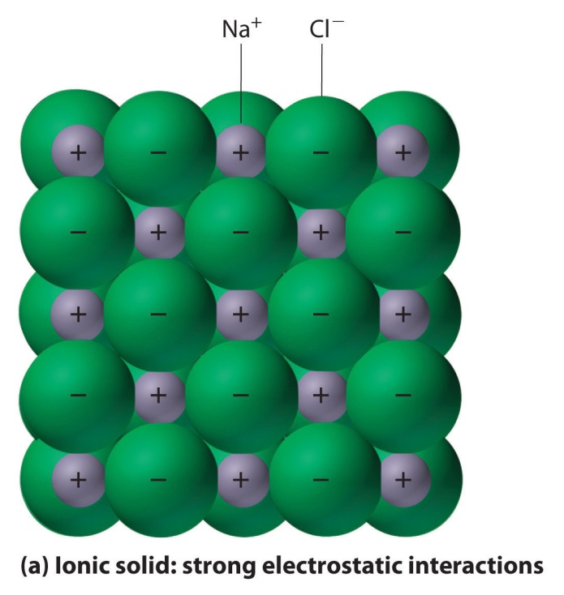
Crystals
A crystal is a substance with a 3-D repeating arrangement of particles called the crystal lattice.
The coordination number of an ion is the number ions of opposite charge that surround the ion in a crystal.

Slide 24
Section 7.2 Assessment
How can you describe the electrical charge of an ionic compound?
What properties characterize ionic compounds?
Write the correct chemical formula for the compounds formed by each pair of ions.
K⁺, S⁻²
Ca⁺², O⁻²
Na⁺, O⁻²
Al⁺³, N⁻³

Slide 25
Section 7.2 Assessment
Write formulas for each compound.
a. barium chloride
b. Magnesium oxide
c. Lithium oxide
d. Calcium fluoride
Which pairs of elements are likely to form ionic compounds?
Cl, Br
Li, Cl
K, He
I, Na

Slide 26
Section 7.3 – Bonding in Metals
The valence electrons of metal atoms can be modeled as a sea of electrons.
Metallic bonds consist of the attraction of the free-floating valence electrons for the positively charged metal ions.
Metals are good conductors and malleable because of their mobile electrons.

Slide 27
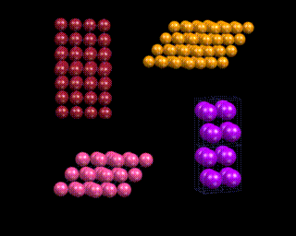
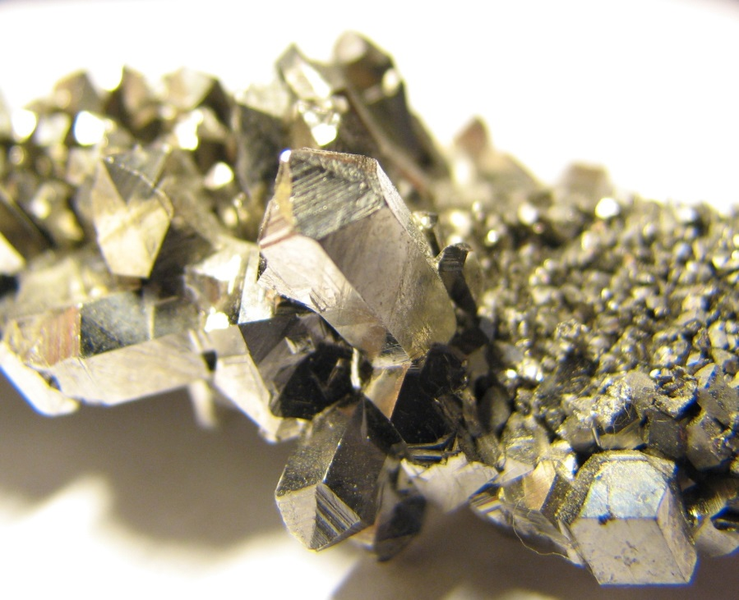
Metals
Metals are the most simple crystals because they contain one type of element.

Slide 28
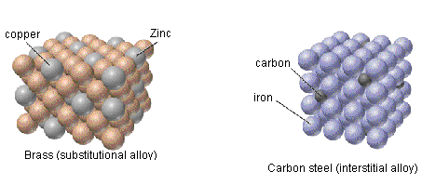
Alloys
An alloy is a mixture with metallic properties.
A substitutional alloy is made when atoms of one metal replace atoms of another metal.
An interstitial alloy is made when smaller metal atoms are inserted in between larger metal atoms.

Slide 29
Section 7.3 Assessment
How do chemists model the valence electrons in metal atoms?
How can you describe the arrangement of atoms in metals?
Why are alloys more useful than pure metals?
Describe what is meant by ductile and malleable.

Slide 30
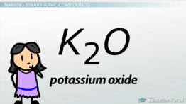
Section 9.1 – Naming with Regular Metals
A monatomic ion is a single atom with a charge. Ex: Na⁺ or O⁻²
When naming a cation, the name of the element does not change. Ex: K⁺ = potassium
When naming an anion, the ending of the element changes to –ide. Ex: O⁻² = oxide

Slide 31
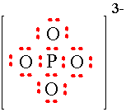
Polyatomic Ions
A polyatomic ion is a group of atoms with an overall charge. Ex: SO₄⁻²
Most polyatomic ions end in –ate or –ite. The ending does not change when naming a compound (unless it is an acid which we will talk about later).
The –ate suffix indicates that the polyatomic ion contains one more oxygen than the polyatomic ion with the –ite suffix. (Ex: sulfate = SO₄⁻², sulfite = SO₃⁻²)

Slide 32
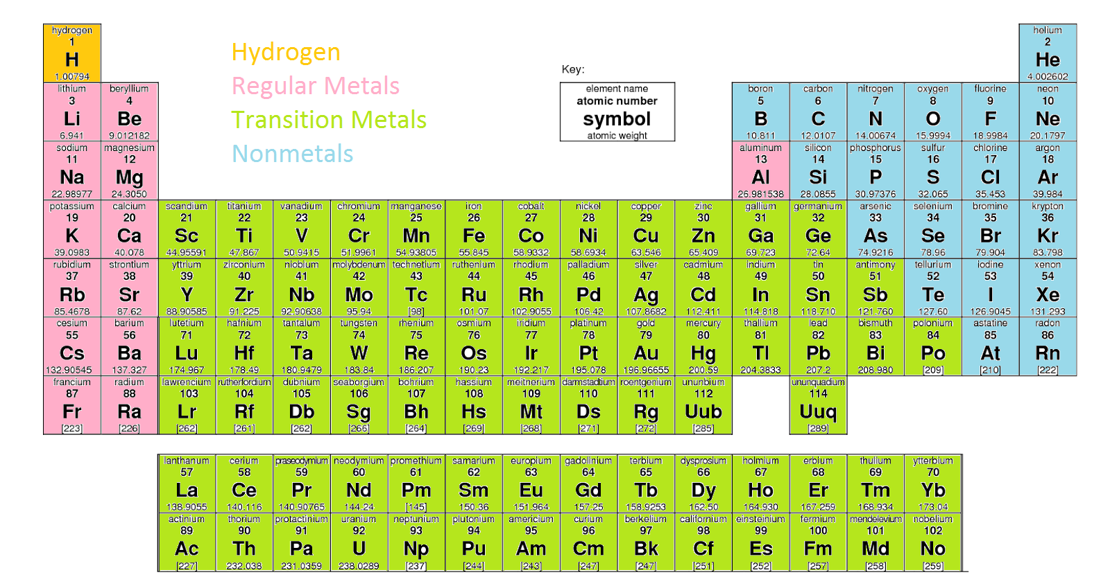
Periodic Table for Naming

Slide 33
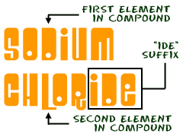
Naming with Regular Metals
The regular metals are located in groups 1 and 2 (except for H). Aluminum is also a regular metal.
When naming a compound that starts with a regular metal, you name the metal (cation) and add –ide to the nonmetal (anion). Ex: NaCl = sodium chloride
If the anion is a polyatomic ion, then you do not change the ending. Ex: CaCO₃ = calcium carbonate

Slide 34
Sample Problems
Name the following compounds:
Na₂O
AlBr₃
Li₂SO₄
Sodium oxide
Aluminum bromide
Lithium sulfate

Slide 35
Practice Problems
Name the following compounds:
LiNO₃
Ca₂(PO₄)₃
(NH₄)₂O
Lithium nitrate
Calcium phosphate
Ammonium oxide

Slide 36
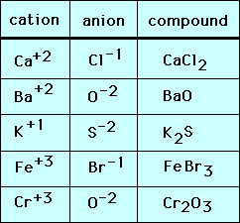
Writing the Formula with Regular Metals
When writing the formula of a compound that starts with a regular metal, you must BALANCE THE CHARGES.
Ex: aluminum bromide
AlBr
balance charges
Al⁺³Br⁻
AlBr₃

Slide 37
Sample Problems
Write the formula for the following compounds:
Aluminum chloride
Calcium acetate
Lithium fluoride
AlCl₃
Ca(C₂H₃O₂)₂
LiF

Slide 38
Practice Problems
Write the formula for the following compounds:
Calcium carbonate
Aluminum oxide
Cesium oxalate
CaCO₃
Al₂O₃
Cs₂C₂O₄

Slide 39
Section 9.1 Assessment
What are the usual ending for the names of polyatomic ions?
How does a polyatomic ion differ from a monatomic ion?
Write the formula for these binary compounds.
Beryllium chloride
Cesium sulfide
Sodium iodide
Strontium oxide

Slide 40
Section 9.1 Assessment
4. Write the formula for these compounds.
a. sodium perchlorate
b. magnesium hydrogen carbonate
c. calcium acetate
5. Identify any incorrect formulas. Explain your answer.
a. Mg₂(SO₄)₃
b. Rb₃As
c. BeCl₃
d. NaF

Slide 41
Section 9.2 – Naming with Transition Metals
Transition metals can have multiple charges, so you cannot tell the charge based on the group it is in.
Since transition metals can have multiple charges, we use a roman numeral to indicate the charge.
Review of Roman Numerals
1 = I
2 = II
3 = III
4 = IV
5 = V
**You should not use a roman numeral over 5.

Slide 42
Transition Metals
When naming compounds that start with a transition metal, you should balance charges to figure out the charge of the transition metal.
Remember add –ide to the anion if it is not a polyatomic ion.
Ex: CuO
we know that O has a -2 charge.
CuO⁻²
to cancel out a -2, Cu must be +2
Cu⁺²O⁻²
so the name would be copper (II) oxide.

Slide 43
Sample Problems
Write the names for the following:
Cu₂O
FeCl₃
PbSO₄
Copper (I) oxide
Iron (III) chloride
Lead (II) sulfate

Slide 44
Practice Problems
Write the name of the following:
PbS₂
Zn(C₂H₃O₂)₂
Ag₃PO₃
Lead (IV) sulfide
Zinc (II) acetate
Silver (I) phosphite

Slide 45
Old Names for Transition Metals
For the old naming system for transition metals, the old Latin names are used with the suffix –ic or –ous.
Ion | Old Name
Fe³⁺ | ferric
Fe²⁺ | ferrous
Cu²⁺ | cupric
Cu⁺ | cuprous
Co³⁺ | cobaltic
Co²⁺ | cobaltous
Sn⁴⁺ | stannic
Sn²⁺ | stannous
Pb⁴⁺ | plumbic
Pb²⁺ | plumbous
Hg²⁺ | mercuric
Hg₂²⁺ | mercurous

Slide 46
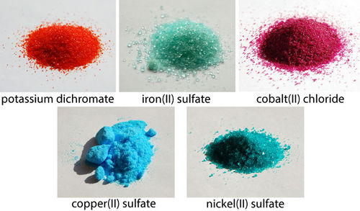
Old Names for Transition Metals
The –ic ending indicates a higher charge, and the –ous ending indicates a lower charge.
When writing the name for a compound, you figure out the charge for the transition metal and then find the old name on the chart.
Ex: FeS
Fe⁺²S⁻²
Fe⁺² = ferrous
FeS = ferrous sulfide

Slide 47
Practice Problems
Write the old names for the following:
Cu₃P
Fe(NO₃)₃
PbS
Cuprous phosphide
Ferric nitrate
Plumbous sulfide

Slide 48
Writing the Formulas for Transition Metals
When writing the formula for a compound that starts with a transition metal, you must BALANCE THE CHARGES.
Ex: vanadium (V) fluoride
VF
balance charges
V⁺⁵F⁻
VF₅
REMEMBER THE ROMAN NUMERAL IS THE CHARGE, NOT THE SUBSCRIPT!!!!!!!!!!!!!!!!

Slide 49
Sample Problems
Write the formula for the following:
Tin (II) permanganate
Mercury (I) oxide
Cobaltic carbonate
Sn(MnO₄)₂
Hg₂O
Co₂(CO₃)₃

Slide 50
Practice Problems
Write the formula for the following:
Gold (II) iodide
Vanadium (IV) nitrite
ferrous chromate
AuI₂
V(NO₂)₄
FeCrO₄

Slide 51
Section 9.2 Assessment
1. Write the formula for chromium (III) nitrite.

Slide 52
THE END

